Slide 1




NEXT GEN EMPLOYABILITY PROGRAM
Creating a future-ready workforce
Team Members
College Name
Student Name :Wafa B
Student ID :au960221104124
Arunachala College of Engineering for Women

Slide 2

CAPSTONE PROJECT SHOWCASE
Project Title
Car Rentals Application with Django Framework
Abstract | Problem Statement | Project Overview | Proposed Solution | Technology Used | Modelling & Results | Conclusion

Slide 3
Abstract
This paper presents the design and development of a comprehensive car rental application aimed at enhancing the user experience in the realm of modern mobility. A car rental application built using the Django framework streamlines the process of renting vehicles for customers. Leveraging Django's powerful features, developers can create a robust platform with functionalities ranging from managing a fleet of vehicles to facilitating customer bookings. Through Django's model-view-template architecture, developers define models to represent cars, customers, and rental transactions, encapsulating their attributes and relationships. Views handle user interactions, such as browsing available cars or making rental requests.
Source :

Slide 4
Problem Statement
In today's fast-paced world, individuals often require flexible transportation solutions for short-term needs such as commuting, travel, or special occasions. However, finding reliable and convenient car rental services can be challenging due to limited availability, complex booking processes, and security concerns. To address this issue, our project aims to develop a user-friendly car rental application using the Django framework The application will provide a seamless platform for customers to browse, book, and manage rental vehicles effortlessly. Key features will include a comprehensive inventory of cars with detailed descriptions, intuitive booking interfaces, secure payment processing, and real-time availability updates. By leveraging Django's robust development tools and best practices, we seek to create a reliable, scalable, and secure solution that enhances the car rental experience for both customers and service providers.
Source :

Slide 5
Project Overview
Secure login.
Manage car details User-friendly interface for browsing available cars.
Allow customers to reserve cars
Admin interface.
Personalized dashboards
Source :

Slide 6
Proposed Solution
Payment Integration:
Integrate a payment gateway such as Stripe or PayPal to facilitate secure online payments for bookings.
User Notifications:
Implement email notifications to send confirmation messages for bookings, reminders for upcoming rentals, and receipts for completed transactions.
Source :

Slide 7
Reviews and Ratings:
Allow users to leave reviews and ratings for cars they've rented to help other users make informed decisions. Create models to store review data and develop views to display reviews alongside car listings.
Responsive Design:
Ensure the application is responsive and accessible across different devices and screen sizes by using responsive CSS frameworks like Bootstrap or implementing media queries in custom CSS stylesheets.
Testing and Deployment:
Write unit tests and integration tests to verify the functionality of the application and ensure reliability. Deploy the application to a production environment using platforms like Heroku, AWS, or DigitalOcean, following best practices for scalability, performance, and security.

Slide 8
User Authentication and Authorization:
Implement a robust authentication system to allow users to sign up, log in, and manage their profiles securely. Utilize Django's built-in authentication system or third-party packages like Django-Allauth for additional features like social authentication.
Car Listings Management:
Create models to represent car listings, including attributes such as make, model, year, price, availability, and images. Use Django's admin interface or build custom forms to allow administrators to manage car listings efficiently.

Slide 9


Technology Used
Front-end
Back-end
Source :

Slide 10
Modelling & Results
The program would involve training employees in utilizing these technologies effectively, developing problem-solving skills, and fostering a customer-centric mindset. Results could include improved operational efficiency, reduced downtime, enhanced customer satisfaction, and a skilled workforce ready to adapt to future industry trends. A Next Gen Employability program for car rentals could focus on incorporating cutting-edge technology such as AI-driven vehicle tracking systems, predictive maintenance algorithms, and customer experience enhancements.
Source :

Slide 11
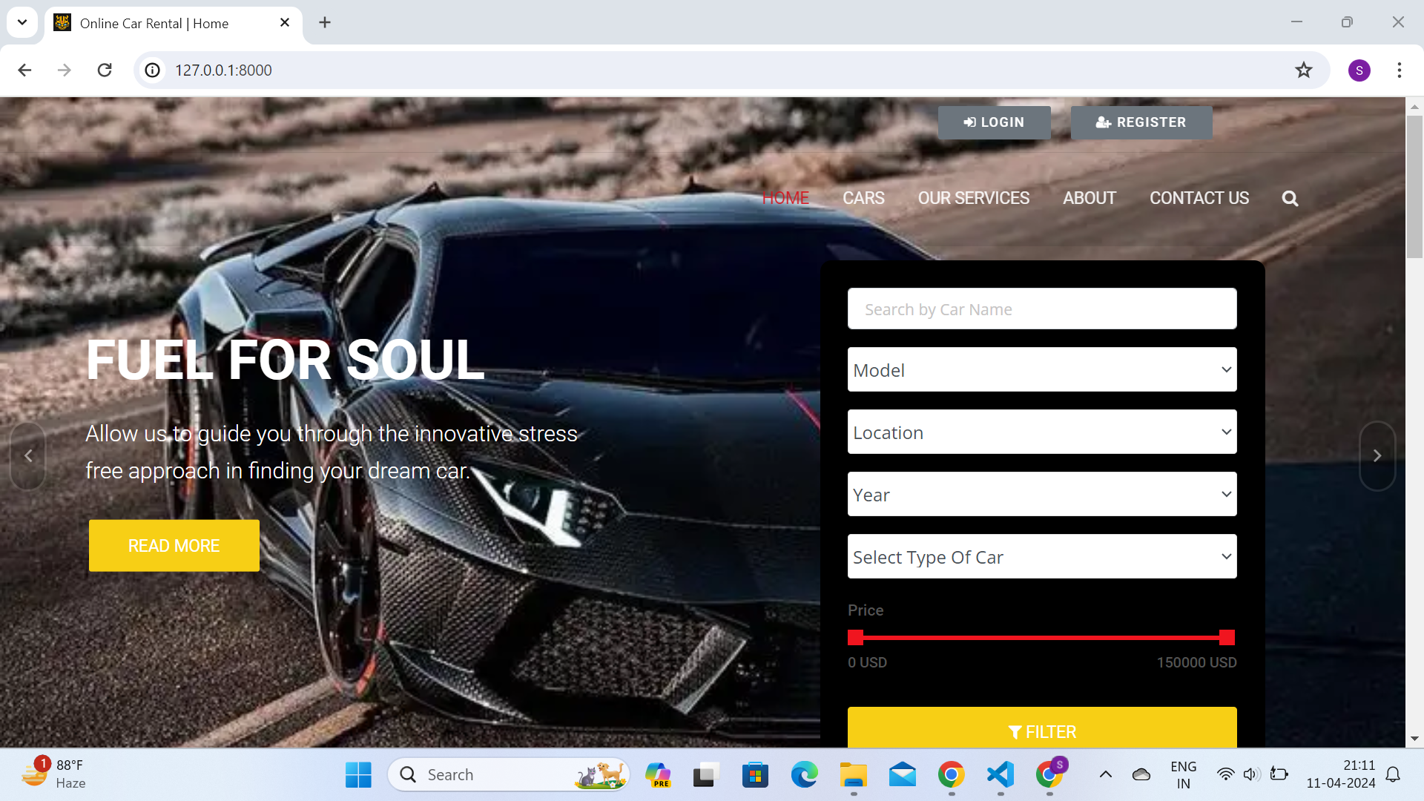
Homepage

Slide 12
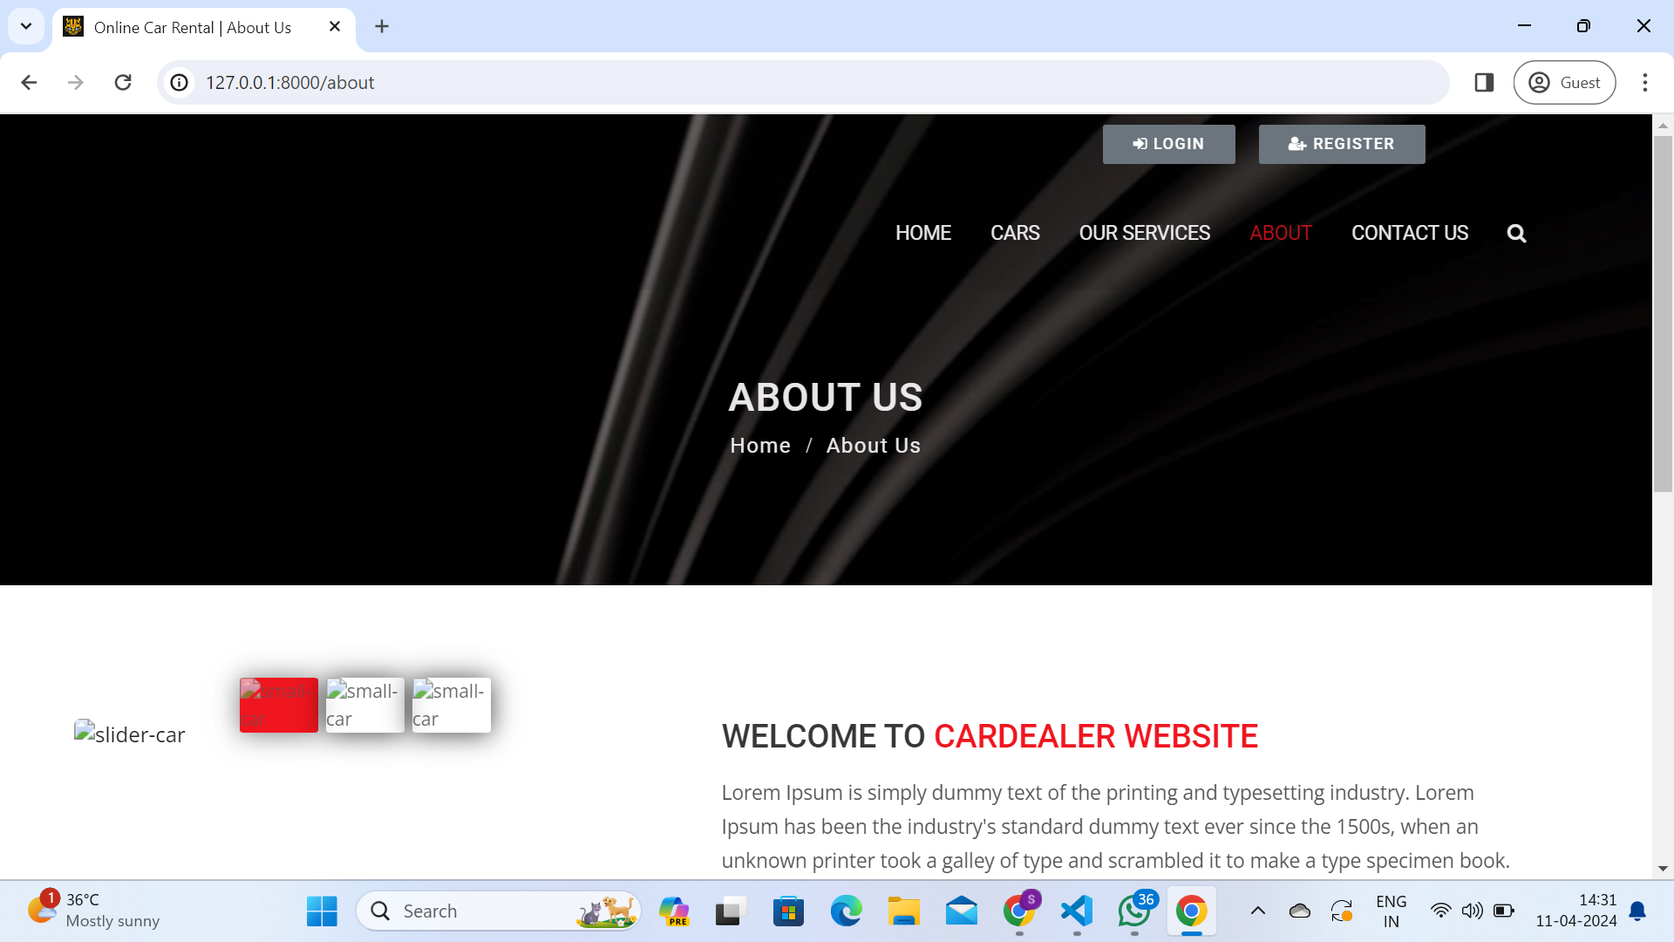
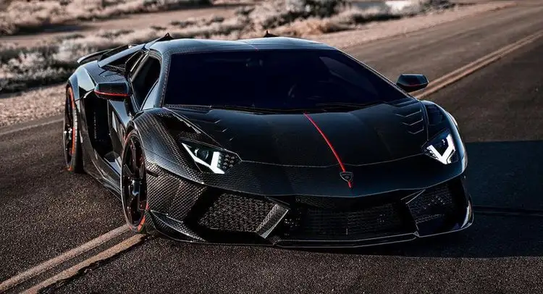
About-Us-Page

Slide 13
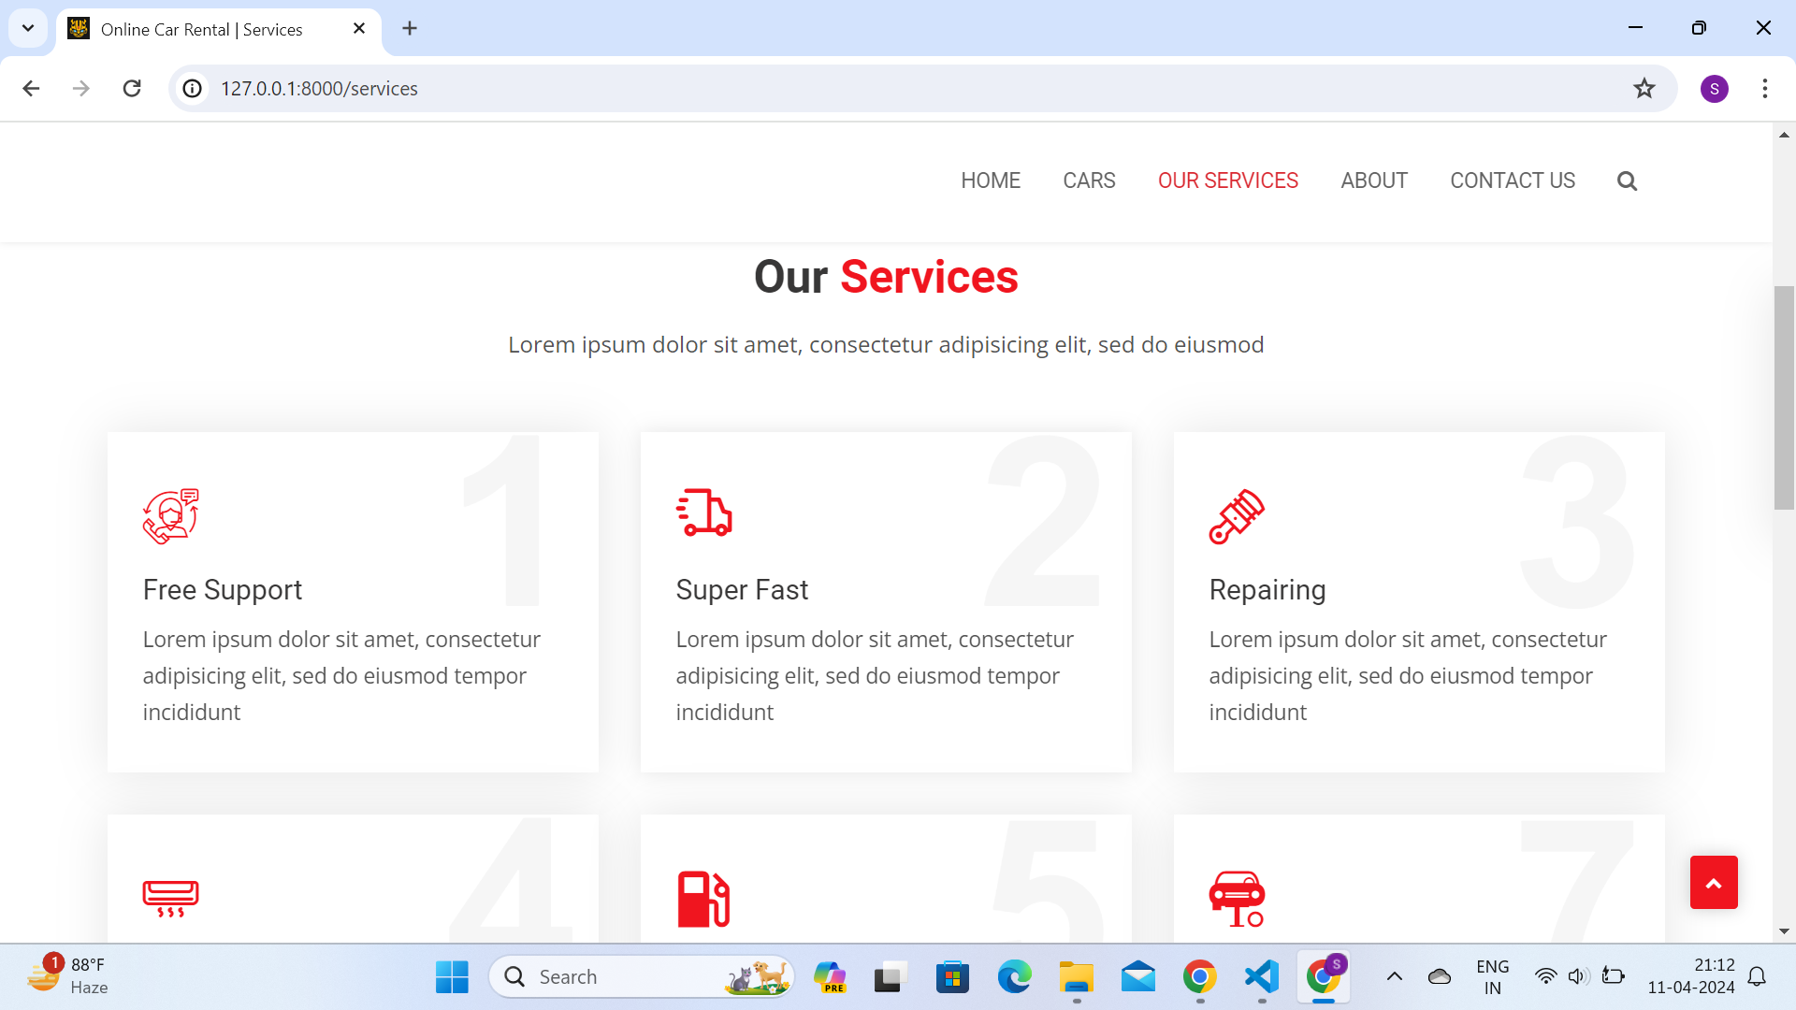
Service-Page

Slide 14
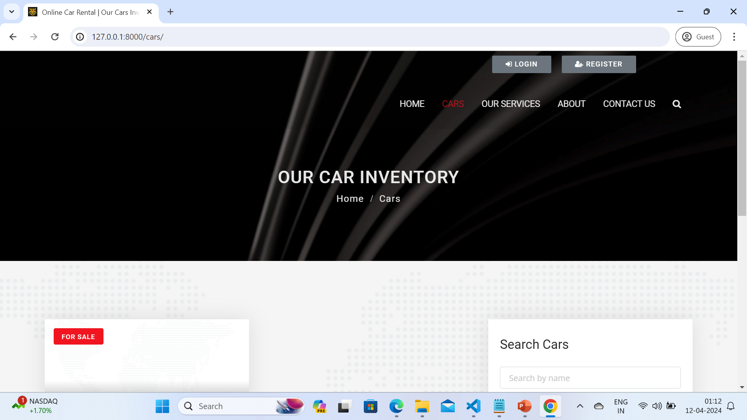
Departments-Page

Slide 15
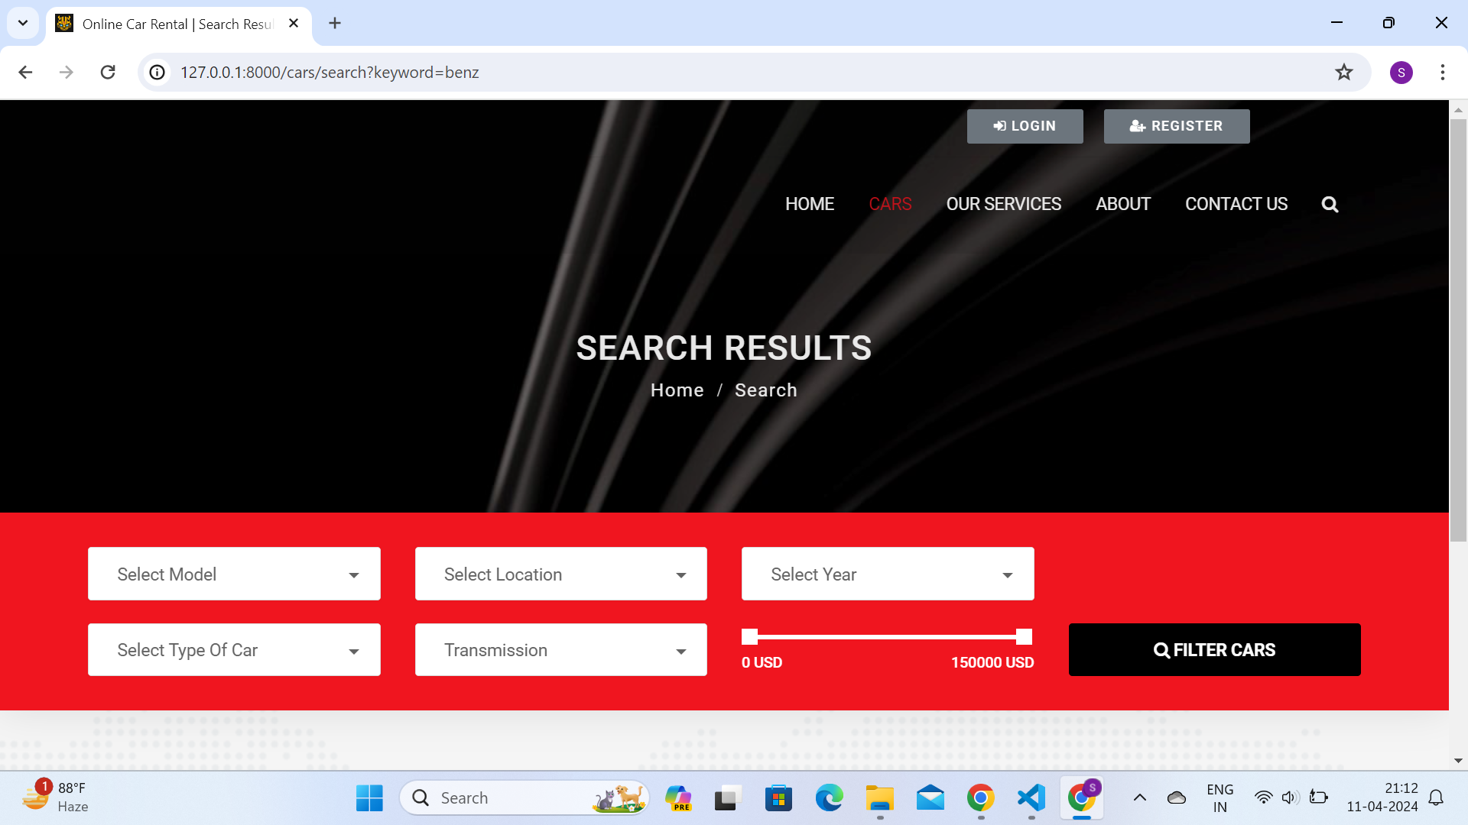
Blog-Page

Slide 16
Future Enhancements:
Security is a top priority throughout the development process, with measures such as HTTPS implementation, input validation, and protection against common web vulnerabilities ensuring the integrity and confidentiality of user data. The application is designed to be responsive and accessible across various devices and screen sizes, accommodating users' preferences for browsing and booking rental cars on the go.

Slide 17
Conclusion
In conclusion, the car rentals application developed on the Django framework represents a significant milestone in modern transportation services.
Through seamless integration of advanced features such as user-friendly booking interfaces, extensive car selection, and secure payment gateways, the application aims to revolutionize the way individuals access rental vehicles.
By prioritizing customer convenience and satisfaction, we have strived to create an intuitive platform that simplifies the entire rental process, from browsing available vehicles to completing transactions.
Source :

Slide 18
Thank You!
Notes:
Thank You !!

